Slide 1


Capstone Project Phase 1
Flying Packages
Project number: 23-1-D-29
Advisor: Prof. Zeev Barzily
Mousa Srour 205798812
Wessam Ghrayeb 211756820
Date: 25/01/2022

Slide 2
Outline
Introduction
the solution
Project architecture
the problem
tests

Slide 3

Introduction
The shipping industry is a main and necessary industry for any business owner who supplies goods.
most suppliers prefer not to deal with deliveries but to purchase the service of an external delivery company that will take care of delivering the products to customers.

Slide 4

The Problem

Slide 5

The problem
Once new order has been received, we need to match the optimal courier to deliver it according to the location and distance to save more time.
Suppliers would prefer to be involved in choosing the courier
Each delivery company aims to maintain efficiency in terms of schedule.

Slide 6

The problem
Today, many delivery companies are solving one of the problems mentioned before.
No solution includes a solution for all the problems.

Slide 7

The Solution

Slide 8


How to match the optimal courier?
We will maintain the location of each supplier.
We will maintain the location of each courier in real-time so that we can determine his location at any moment.
We will calculate the distance from each courier to the supplier’s location and choose the courier for which we will get the shortest distance.

Slide 9
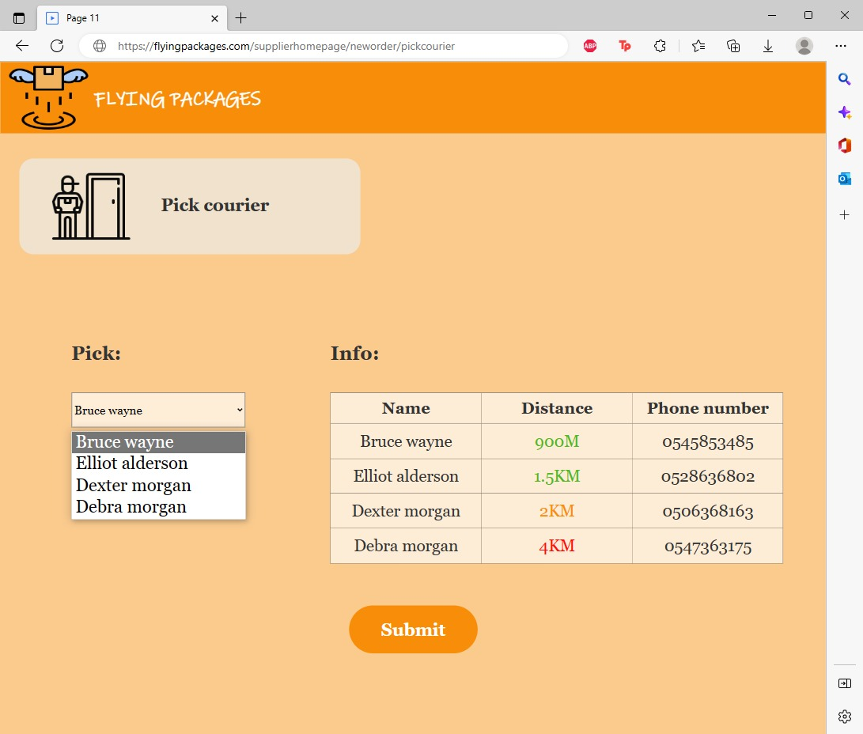

How to involve the supplier in choosing the courier?
We will find K couriers with the shortest distance using KNN (K nearest neighbors), present them to the supplier and let him choose one of them.

Slide 10
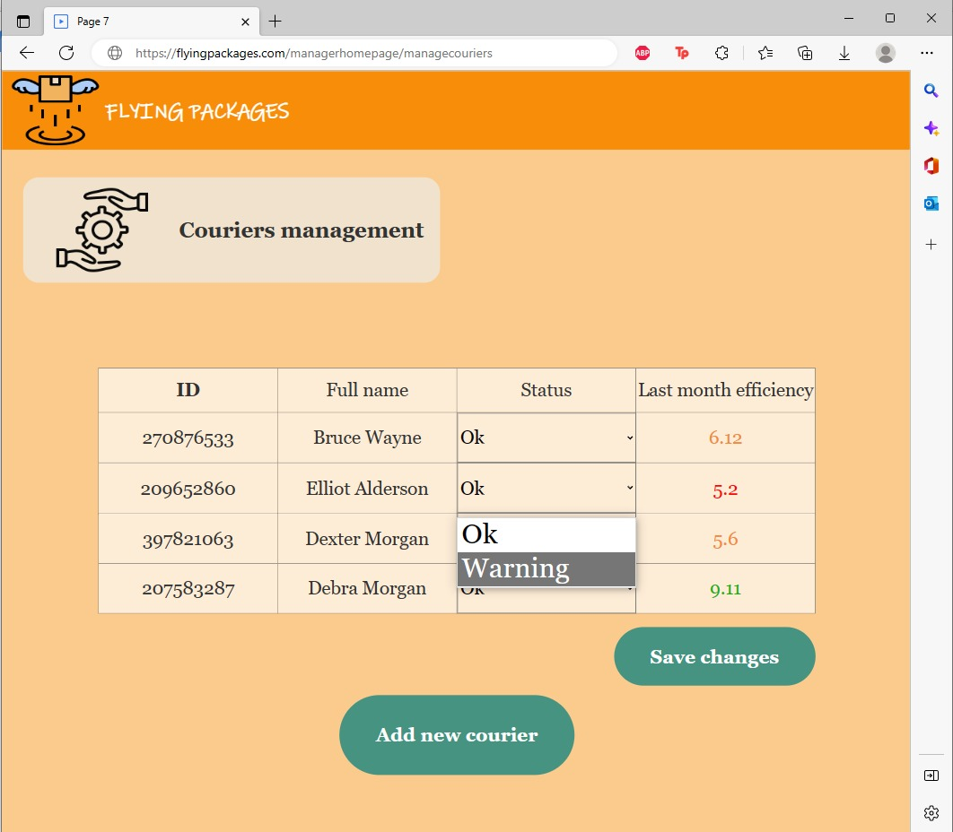

How to accomplish the aim of the delivery company?
For each courier, we will maintain a variable whose meaning will be efficient for the courier.
The variable’s value will depend on how many deliveries the courier made in a month and the average time the courier made his deliveries.
We will improve the system’s efficiency by defining a threshold value so that the effectiveness of each courier should not exceed it.

Slide 11





Our solution
Fast delivers
The supplier involved in choosing the courier
Delivery by one of the closest couriers
Win-win for the suppliers and for the company

Slide 12

Project architecture

Slide 13
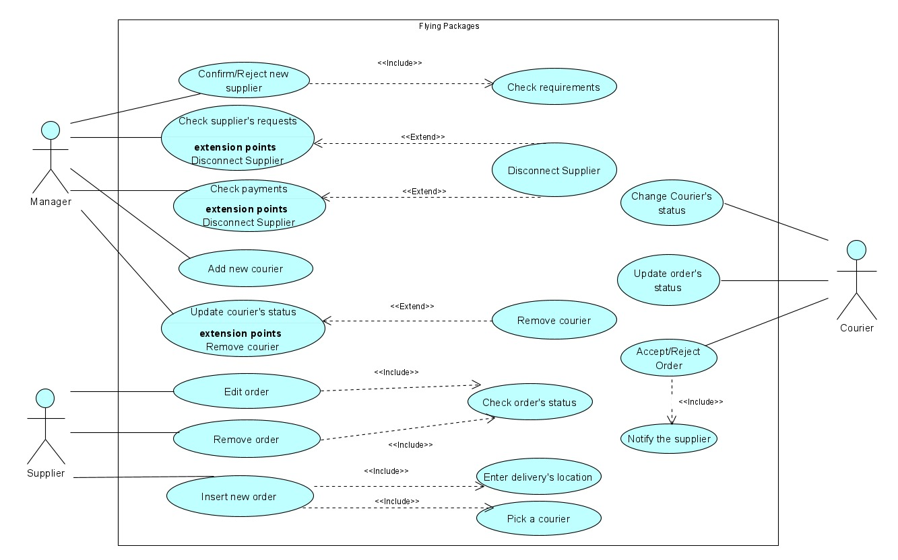
Use case diagram

Slide 14
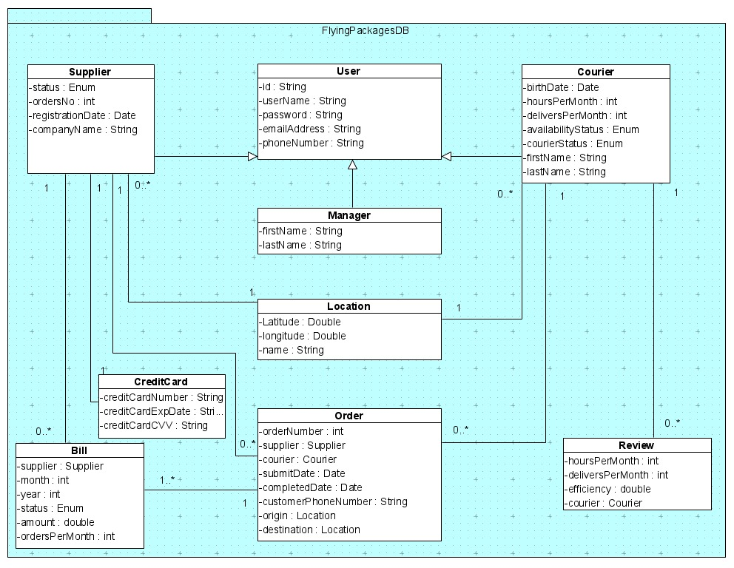
Class diagram

Slide 15
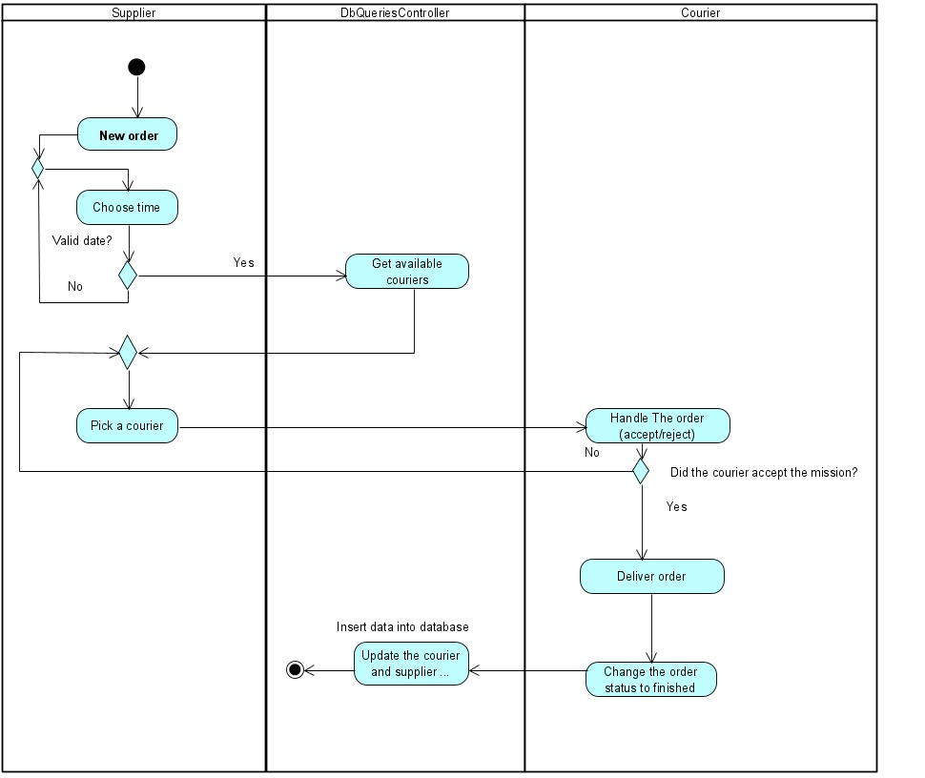
Activity diagram - order

Slide 16

Verification and Evaluation

Slide 17
Unit tests
#No | Test Subject | Expected result
Login form
1 | Enter an empty username or password | Error displays a message: “Please fill in the fields”.
2 | Enter the wrong username or password | Error displays a message: “Invalid details, try again” We don’t want to give information about which field is invalid.
3 | Log in with a ‘frozen’ status username and password | Display message: “User is Frozen”.
4 | Enter a valid username and password | Display message:” Login succeed”.

Slide 18
Unit tests
No# | Test Subject | Expected result
Supplier’s registration form
5 | Enter an existing name and location | Error display a message: “This supplier is already existing”
6 | Enter empty details (one or more) | Display message: “Please fill in the fields”.
7 | Enter valid details | Display a message: “Registration succeed, please wait for approvement”.

Slide 19
Functional Tests
No# | Test Subject | Expected result
Add new order
8 | Submit a new order from the supplier’s form. | The order will appear in the order list in the manager’s form.
9 | The optimal courier for the mission has been found. | The courier gets an SMS that includes the delivery details.
10 | The courier confirms that he will handle the order | The order’s status will change from ‘pending’ to ‘in progress’.
11 | The courier updates that he finished his mission | The order’s status will change from ‘in progress’ to ‘completed’

Slide 20

Thank you for your attention

